Slide 1
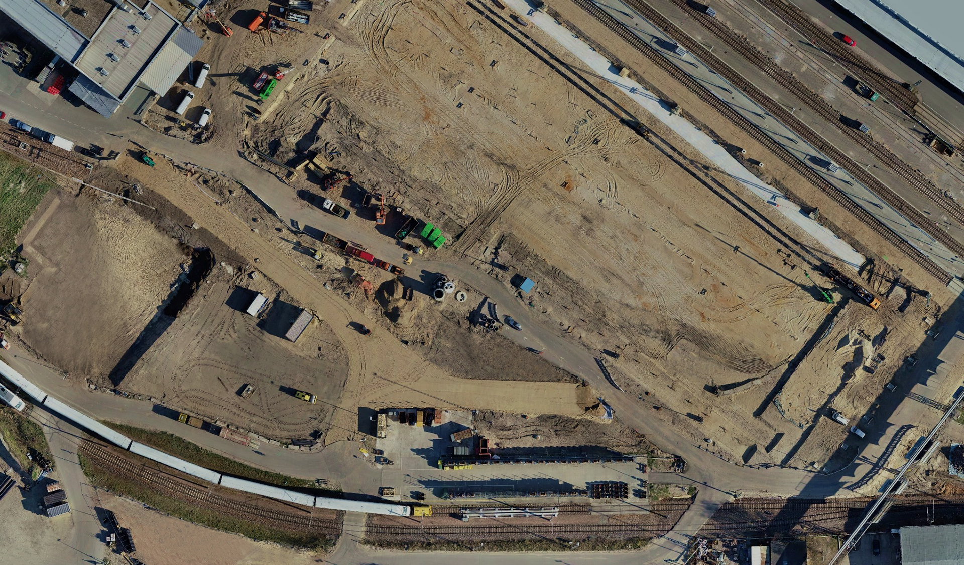
Drones2BIM — data usage from different perspectives
Our UAS services
Photo: Jan Brunkal
DB Engineering & Consulting | September 2021

Slide 2
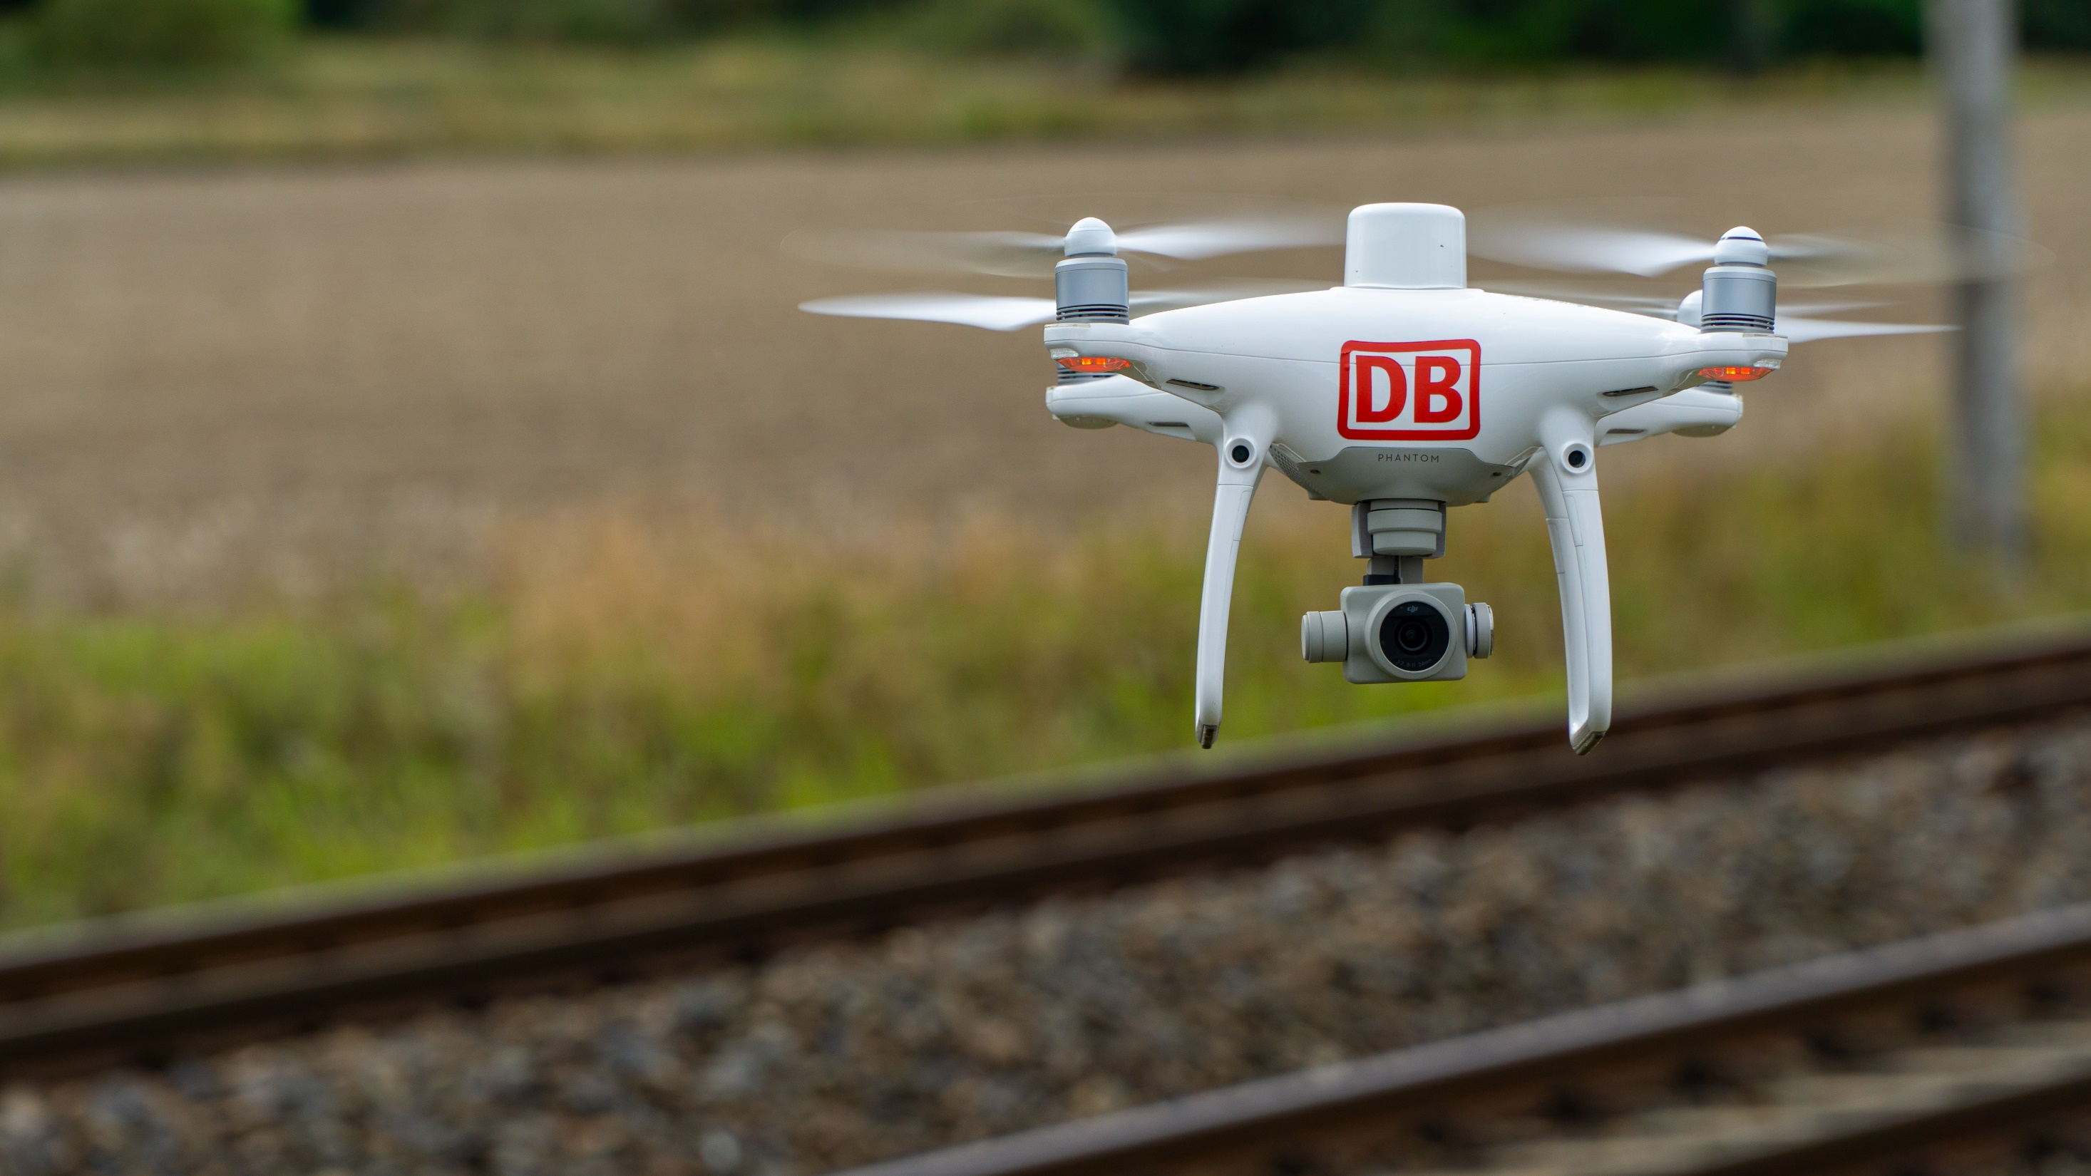
Drones2BIM — Overview of our service portfolio
Photo: Jan Brunkal

Slide 3
Drones2BIM — valuable addition to the DB E&C portfolio
Digitaliz-ation consult-ing
Testing
Condition monitor-ing
Drones2BIM UAV platform
Preparing and performing flights
Com-missioning
Data platform
Planning
Construc-tion opera-tions planning
Data analysis and refinement
BIM
Implement-ation manage-ment
Project manage-ment
Environmental & geo-services
Construction supervision
Geo-monitor-ing

Slide 4
Drones2BIM — comprehensive services from a single source
Preparing and performing flights
Pilots take drone flying examination and flights are planned in line with aviation laws
All necessary approvals are obtained
Federal police (Bundespolizei) and local residents are informed
Signing on and signing off with signal setter
Professional flying – by trained pilots only
Quality check on raw material
Flight documentation
Digitalization and referencing of design documents
Preparing and performing flights
Data platform
Data platform
Secure upload of raw data
Fully automated photogrammetry process
High-quality end products – available just a few hours after flight
Browser-based usage for end users
Integration of design documents
Access control by means of extensive rights scheme
Data analysis and refinement
Data analysis and refinement
Customizing
AI processes, for example for further analysis
A wide range of products – exactly according to your needs

Slide 5
How does Drones2BIM work? Highest technical standards and automation
Raw data
Data upload
Fully automated photogrammetry process Orthophoto, 3D point cloud, digital surface model
Browser-based application
Usage
Download function and report export
Export
AI Pixelization of persons and recognition of infrastructure objects
Drones2BIM central data platform
Design data

Slide 6
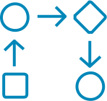
Drones2BIM accompanies the asset life cycle Added value in conventional processes — from start of project through to operations
Governance
Project start
Project implementation
Project closure and commissioning
Operations
Approvals, flight planning, data privacy
Inventory, virtual site visits
Comparison with drawings
Environment mapping
Evidence collection
Site visits during planning
Variance analysis
Defect management
Environmental and site logistics, testing safety measures
Accounting data validation
Support for acceptance processes
Conformity check on as-built document
As-built analysis

Slide 7
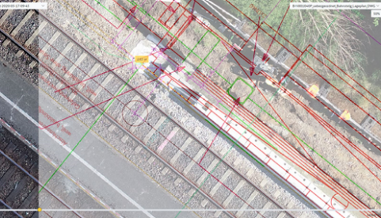
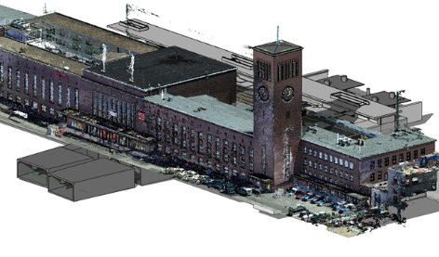
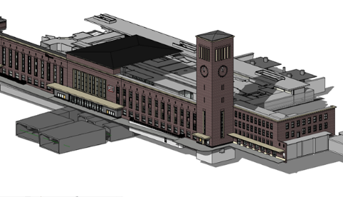
Drones2BIM paves the way for BIM processes Data bases can be generated quickly and for large areas within the asset life cycle
Project start
Planning phase
Project implementation
Project closure and commissioning
Opera-tions
BIM-capable data bases
3D as-built modeling
Object-oriented 3D modeling enables:
Study of design options
Collision test
Simulation of construction processes
Variance analysis
Digital collaboration
As-built modeling for "digital twin"
As-built analysis
Maintenance of "digital twin
Photo: Alexander Winz, Tammo Denkena, Jan Brunkal (2)
Creation of a
"digital twin" from drone survey data

Slide 8
Drones2BIM reduces costs and increases efficiency
Increased efficiency
Modern measuring equipment and methods
Any location
Reduced impact on operations
Complete overview in a matter of seconds
Photo: Finn Hildebrand

Slide 9
Benefit from our long years of experience
Small applications on case-by-case basis with focus on surveying and construction progress. Benefit seems apparent but input in terms of time and costs is high.
As a result of increased demand for UAV support, the Drones2BIM innovation project is initiated to make processes more professional.
Widespread deployment with fully automated data preparation including AI starts live test phase
Drones2BIM begins
Cloud platform launched
First missions
2015
2016
2017
2018
2019
2020
2021
Initial tests
BIM pilot project
Decision for live system
Looking ahead
DB E&C takes interest in UAS. Test acquisition of multicopters and testing during operation.
Deployment of UAS in a BIM pilot project over 20 km; parallel deployment in various pilot projects.
Extensive market analyses and further pilot projects. In-house development implemented for technical and economic reasons.
Widespread deployment of UAS for own use on construction sites and for customer orders. Ramp-up:
2020 500 flights, 2021 >2000 flights

Slide 10
Drones2BIM — Products in detail
Photo: Jan Brunkal

Slide 11
What we offer in flight preparation and execution
Approval processes, data collection & data privacy
High resolution photo and video data
Data collection in compliance with legal and data privacy requirements in the form of a complete service package
Wide-ranging applications thanks to new perspectives

Slide 12
Approval processes, data collection and data privacy We offer a complete package in compliance with legal requirements
Legal framework
Implementing Regulation (EU) 2019/947 | German Civil Aviation Act (Luftverkehrsgesetz, LuftVG) | German Civil Aviation Ordinance (Luftverkehrs-Ordnung, LuftVO) | GDPR | German Ministry of Transport and Digital Infrastructure (BMVI) | German Federal Aviation Office | regional aviation offices | police | local authorities | property owners
Services
DB E&C
Handling approval and risk processes according to LuftVO
Obtaining individual flight permissions according to LuftVO
Obtaining necessary consents and permission to enter properties
Flight preparation and execution, data collection and flight documentation
GDPR-compliant data processing
Benefits
Efficient and targeted obtaining of permissions through direct contact with authorities and close dovetailing within the Group
Nationwide location coverage and flexible deployment options
GDPR-compliant evaluation and presentation on online platform
Complete service package for flight planning and data collection
Photo: Michael Maronde

Slide 13
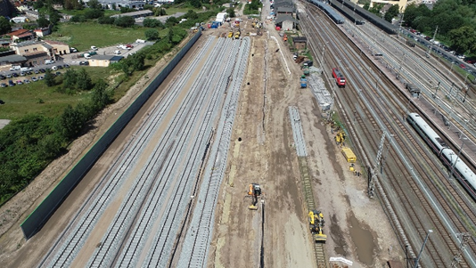
High-resolution photo and video data Wide range of applications thanks to new perspectives
Areas of application
Public relations | marketing | progress documentation | as-built survey | basic evaluation planning | construction supervision | environment | inspection | maintenance
Precision
Photos in 20 MP resolution (5472 x 3648 px)
Videos in 4 K resolution (3840 x 2160 px)
Photo: Arturo Peralta Calderon
Services
DB E&C
Recording and provision of high-resolution photo and video data
Support for disaster relief forces from trained personnel when damage occurs
Processing of photo and video products on request
Benefits
Photos from impressive perspectives for advertising purposes
Inspections without disrupting operations
Photos in rough terrain
Photo: Stephan Niehoff

Slide 14
What our Drones2BIM platform has to offer
Orthophotos
3D point cloud
Variance analysis and histories
Inspection flight with photorealistic point cloud
Viewing and comparison over time with a bird's eye view.
Digital three-dimensional mapping of inventory in the shortest possible time
Technical tools in the Drones2BIM platform enable comparison and documentation in a matter of seconds
Inspection with high-resolution image data wherever the location

Slide 15
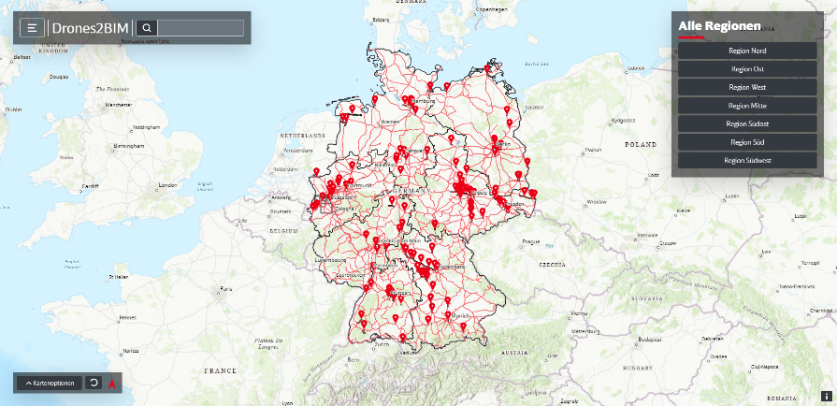
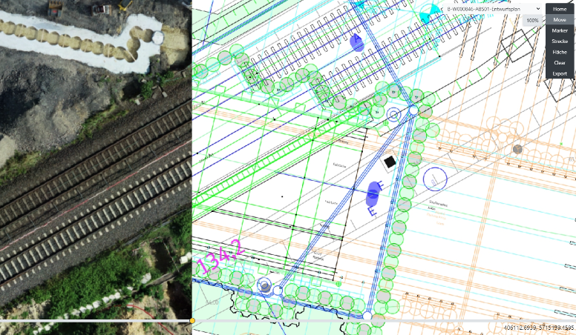
Drones2BIM — the powerful platform Intuitive, simple and versatile use
Technology
Cloud-based overall solution for upload processes, photogrammetry, AI processes and data storage or hosting at the highest technical standard
Web-based user interface for maximum flexibility
Photo: Tammo Denkena
Features
Provision of the products: orthophoto and point cloud
Commonly used measuring tools: distance, area, volume, cross section
Variance analysis by means of geo-referenced drawing integration and overlay
Visual and analytical comparison of condition over time
Export function for all data and reports
Inspect function (in the future)
Comprehensive rights scheme, easy access via Microsoft 365 accounts
Benefits
Entire process GDPR-compliant
Web application accessible from the internet any time, any place
Efficient processes without the need for site inspection or track closure
Transparent and reproducible (measurement) data
Simple use of data without in-depth knowledge
Photo: Thomas Hulboj

Slide 16
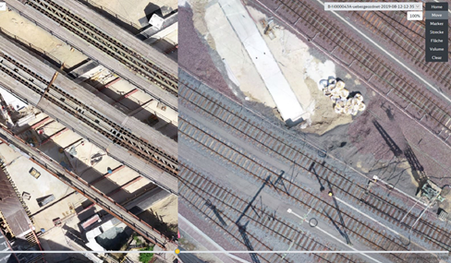
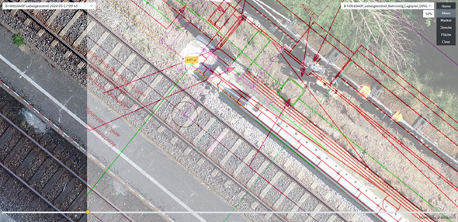
Orthophotos Option of viewing and comparison over time from a bird's eye view
Areas of application
As-built survey | as-built analysis | basic evaluation planning | planning | construction supervision | progress documentation | acceptance processes | environment | inspection | maintenance
Precision
Internal measurement accuracy x/y: up to 1 cm (→ measurement between objects in the image)
External position accuracy x/y: up to 3 cm (RTK standard)
External position accuracy x/y: up to 1 cm
(with ground control points)
Services
DB E&C
Creating an orthophoto with a resolution of 1 cm per pixel
Provision on the platform or as an export
Integration of geo-referenced drawings for overlaying
Benefits
Precise measurements of distances, areas and volumes
Variance analysis possible based on current state
Data can be integrated unchanged as a basis for planning
High-precision digital overview of large areas
Photo: Tammo Denkena (2)

Slide 17
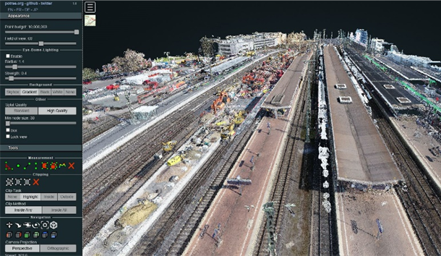
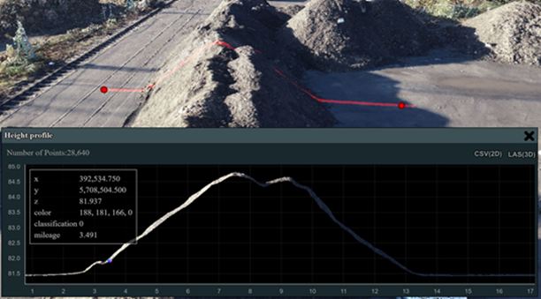
3D point cloud Digital three-dimensional image of inventory
Areas of application
As-built survey | as-built analysis | basic evaluation planning | progress documentation | as-built comparison | vegetation monitoring | environment
Precision
Internal measurement accuracy x/y: up to 1 cm z: up to 3 cm (→ measurement between objects in the image)
External position accuracy x/y: up to 3 cm z: up to 5 cm (RTK standard)
External position accuracy x/y: up to 1 cm z: up to 2 cm
(with ground control points)
Services
DB E&C
Creation of a 3D point cloud with point spacing of 2.5 cm in the raster
Provision on the platform or as an export in the desired format
Benefits
Precise measurements of distances, areas, heights and volumes
Basis for determining height profiles and cross sections
Digital twin of inventory, basis for DTM and BIM as well as for as-built comparison and as-built model
High-precision digital overview of large areas
Photo: Thomas Hulboj (2)

Slide 18
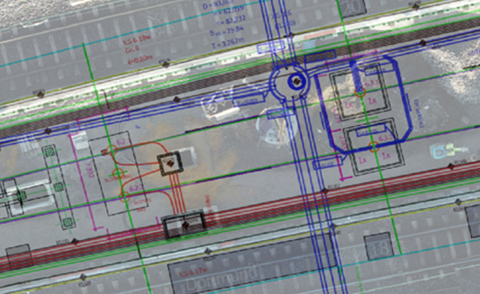
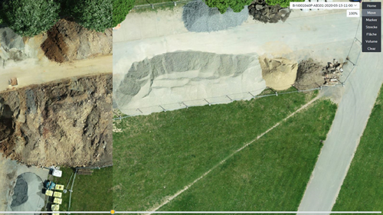
Variance analyses and histories Technical tools for analysis within seconds
Areas of application
As-built survey | as-built analysis | basic evaluation planning | planning | construction supervision | progress documentation | invoicing | acceptance processes | environment | inspection | maintenance
Photo: Thomas Hulboj
Precision
Internal measurement accuracy x/y: up to 1 cm (→ measurement between objects in the image)
External position accuracy x/y: up to 3 cm (RTK standard)
External position accuracy x/y: up to 1 cm
(with ground control points)
DB E&C services
Provision of powerful analysis tools on the Drones2BIM platform incl. annotation and reporting functions
Individual analysis on request incl. creation of reports (check locations of infrastructure assets, position check for technical installations, cable route check, etc.)
Benefits
Variance analysis between geo-referenced drawing and orthoimage (2D) and between model & point cloud (3D)
Advanced monitoring options, early detection and documentation of deviations from the drawing and conflicts
Saves functional departments having to carry out surveying services and local measuring jobs
Photo: Tammo Denkena

Slide 19
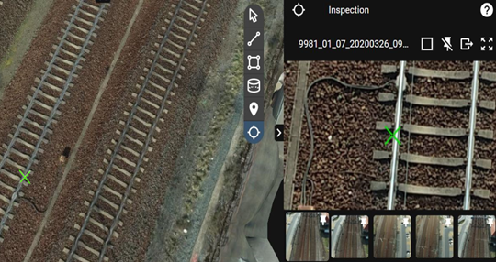
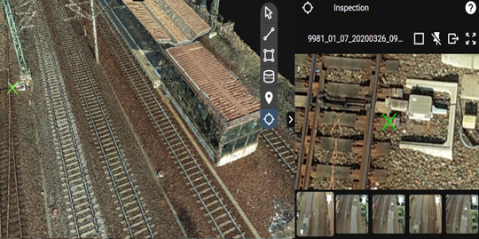
Inspection flights with photorealistic point clouds Inspections with high-resolution image data wherever the location
Coming soon ..
Areas of application
As-built survey | basic evaluation planning | construction supervision | environment | inspection | maintenance
Precision
Photos in 20 MP resolution (5472 × 3648 px)
Services
DB E&C
Generation of 3D point clouds whose individual points contain information from several individual images
Provision of the inspect function on the platform
Benefits
Direct access to high-resolution and referenced individual images
Precise representation of important object details or details of location (infrastructure asset, components, flora, fauna, etc.)
Digital detection and assessment of defects
Annotation functions and immediate documentation
Photo: Chris Hobusch (2)

Slide 20
Professional data refinement and analysis as custom services
Digital model of terrain – with and without breaklines
As-built documentation and analyses
As-built modeling
Environmental services
We create a professional BIM data basis according to your needs.
Do you have specific questions? We will analyze and document your inventory in a targeted manner.
You need your inventory as a model? We will gladly take care of it.
We make cross-cutting perspectives that can also be used for environmental work.

Slide 21
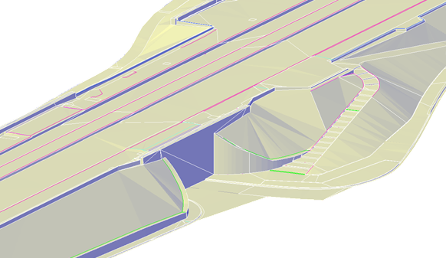
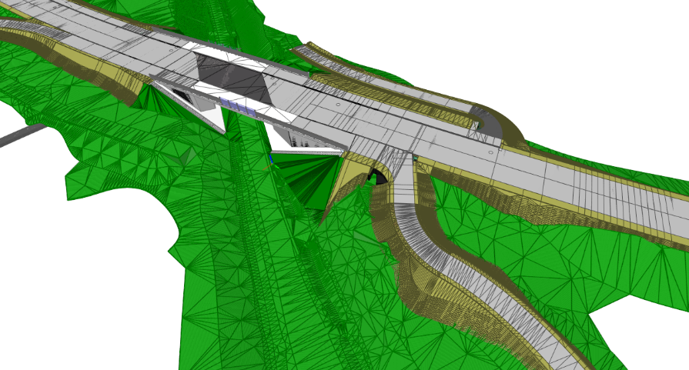
Digital terrain model with and without breaklines Important basis for BIM processes
Areas of application
As-built survey | as-built analysis | basic evaluation planning | planning
Photo: Jan Brunkal
Precision
For technical reasons, this application makes it absolutely necessary to work with ground control points.
Internal measurement accuracy x/y: up to 1 cm z: up to 2 cm
(with ground control points)
External position accuracy x/y: up to 1 cm z: up to 2 cm
(with ground control points)
Services
DB E&C
Custom service upon request
Creation of a customizable DTM according to customer requirements (raster)
Model can be delivered in all commonly used formats (e.g. REB, DXF, 3D-DWG, TXT)
Provided as download
Photo: Andreas Kohestani
Benefits
Can be implemented in BIM software

Slide 22
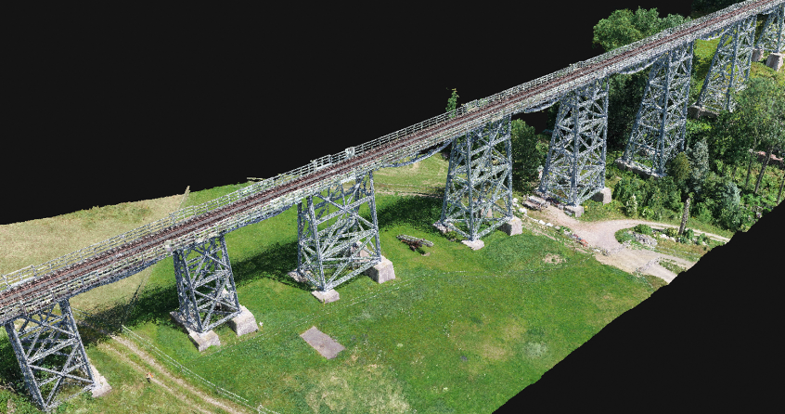
As-built documentation and analysis Digital data provides an extended basis for analyses
Areas of application
As-built analysis | as-built documentation | inspection | maintenance
Precision
Internal measurement accuracy x/y: up to 0.5 cm z: up to 3 cm (→ measurement between objects in the image)
External position accuracy x/y: up to 2 cm z: up to 5 cm (RTK standard)
External position accuracy x/y: up to 1.5 cm z: up to 3 cm
(with ground control points)
Services
DB E&C
Custom service upon request
Customized analyses carried out and documented based on customer-specific questions, e.g.:
High-resolution component documentation – even in inaccessible positions
Analysis and comparison of as-built drawings
Analyses of distance between objects and of undeveloped land
AI approaches are used when necessary and possible
Photo: Chris Hobusch (2)
Benefits
Reduction of location-dependent processes and operational influences
Basis for condition-based or predictive servicing and maintenance tasks

Slide 23
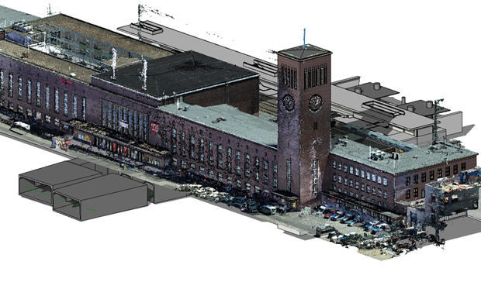
As-built modelling Creation of bases for BIM input data
Areas of application
As-built survey | as-built modelling | basic evaluation planning | planning | as-built modelling and digital twin
Precision
External position accuracy x/y: up to 3 cm z: up to 5 cm (RTK standard)
External position accuracy x/y: up to 0.5 cm z: up to 1 cm
(with ground control points)
BIM LOD (= Level of Detail): 100–400 ​
Photo: Jan Brunkal (2)
Services
DB E&C
Custom service upon request
Removal of outliers and surface smoothing
Data enhancement, modeling and object classification based on the 3D point cloud according to the customer's wishes
Provision in standardized form for rapid integration into commonly used BIM planning software
Benefits
High-quality bases for as-built model including classified objects as a starting point for further processes
Fig.: Revit model from point cloud

Slide 24
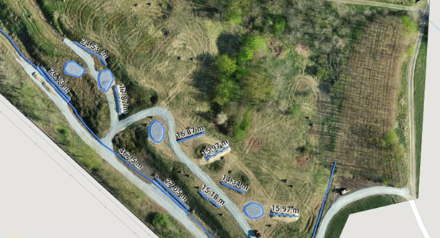
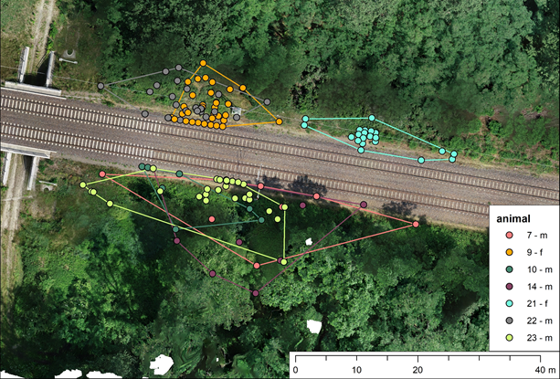
Environmental services Cross-cutting perspectives also provided for environmental work
Areas of application
Environmental construction supervision | biotope mapping | planning | construction drawings for environmental impact mitigation | fauna cadastre | determining the features of excavation pits | environmental remediation
Photo: Tammo Denkena
Precision
Internal measurement accuracy x/y: up to 1 cm z: up to 3 cm (→ measurement between objects in the image)
External position accuracy x/y: up to 3 cm z: up to 5 cm (RTK standard)
Services
DB E&C
Creating an orthophoto with a resolution of 1 cm per pixel (increased precision possible by means of ground control points)
Provision on the platform for conventional measurements and variance analyses incl. integration of geo-referenced designs as well as the possibility of export or integration via WMS service
Custom services on request (preparation of expert opinions, environmental impact designs)
Fig.: Checking the location and dimensions of habitat areas
Photography: Sascha Neumann
Benefits
High-precision digital overview of large areas – without local inspection and data acquisition
Significant time savings in as-built survey, processes accompanying measures , monitoring of protective measures, etc.
Precise measurements and documentation for many environmental issues – even in rough terrain
Fig.: Representation of a lizard population by the track with high-resolution orthophoto as data basis

Slide 25
And we can do everything else too.
Please contact us.
Photo: Volker Emersleben

Slide 26
Our projects
Photo: Jan Brunkal

Slide 27
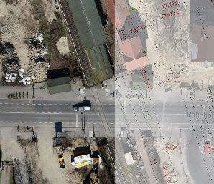
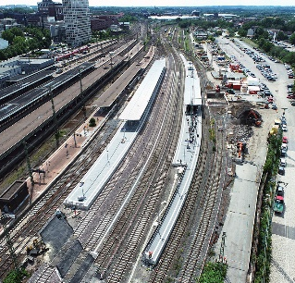
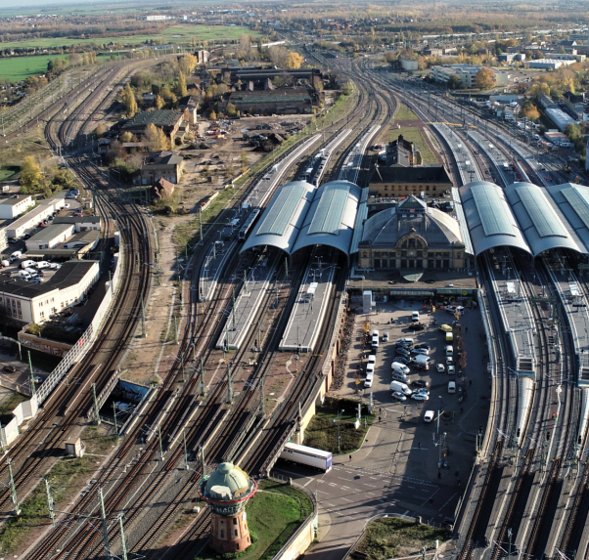
Our projects Selection of projects in which Drones2BIM provided valuable support
Construction of new S4 rapid transit line in Hamburg region
Construction of a new rapid transit line between Hamburg-Altona and Bad Oldesloe
Drones2BIM to support digital as-built documentation and determination of actual work performed using high-resolution orthophotos
Number of flights: approx. two a month
Dresdner Railroad (Berlin Südkreuz – Blankenfelde)
Upgrading, electrification and extension of existing track system to relieve congestion at Berlin transport hub
Drones2BIM to support documentation, analysis and determination of actual work performed, e.g. in underground cable installation and track-installed switching devices as well as for as-built documentation
Dortmund Main Station
Extensive modernization without disrupting operations
Drones2BIM for supporting claims management, determination of actual work performed, with surveying services
Number of flights: approx. three a moth
Halle junction
Aerial survey of the Halle rail junction incl. train-handling sidings, main station, traffic infrastructure, airport and all feeder lines
Generation of high-resolution geo-referenced orthophotos for comparison with as-built drawings
Photo: Finn Hildebrand (Hamburg), Thomas Hulboj (Dortmund), Chris Hobusch (Fürth), Sascha Neumann (Berlin), Chris Hobusch (Halle, Treuchtlingen)
Aerial survey Fürth - – Gemünden line
New-build: Aerial survey of a 130-kilometer-long line section including all stations en route
Drones2BIM for digital as-built documentation
All flights executed within one month
Aerial survey of cliff faces near Treuchtlingen
Aerial survey of cliff faces that are difficult to access
Generation of high-resolution orthophotos for as-built documentation
No need for special climbers within the scope of the inspection intervals

Slide 28
Contact
→ More information on the web:
www.db-engineering-consulting.com/uas
→ E-mail address for inquiries:
drones2BIM@deutschebahn.com

